Slide 1
Superbowl Ad Breakdown: Who Won the Battle on X?
Feb
9
Bayesian Ballers: Prachi Aswani, Jack Doughty, Tobias Lux and Nicolaus Bayard
Notes:
"Good afternoon, everyone. My name is Prachi Aswani, and I, along with my team, Bayesian Ballers, am excited to present our analysis on 'Super Bowl Ad Breakdown: Who Won the Battle on X?' As we all know, the Super Bowl is not just a sporting event; it’s a battleground for brands competing for consumer attention. Today, we’ll walk you through how brands performed on social media, what drove engagement, and the business impact of these multi-million-dollar ad investments."

Slide 2
01
Introduction
TABLE OF CONTENTS
02
Objectives and KPI’s
03
Ground Facts
04
Engagement Metrics
05
Sentiment Analysis
06
ROI and Stock Market
Notes:
"Here’s an overview of what we’ll be covering today. We’ll start with an introduction to why Super Bowl ads matter, followed by our objectives and key performance indicators. Then, we’ll present data-backed insights on ad engagement, sentiment analysis, and ROI implications. Finally, we’ll discuss challenges we faced and key takeaways for advertisers."

Slide 3
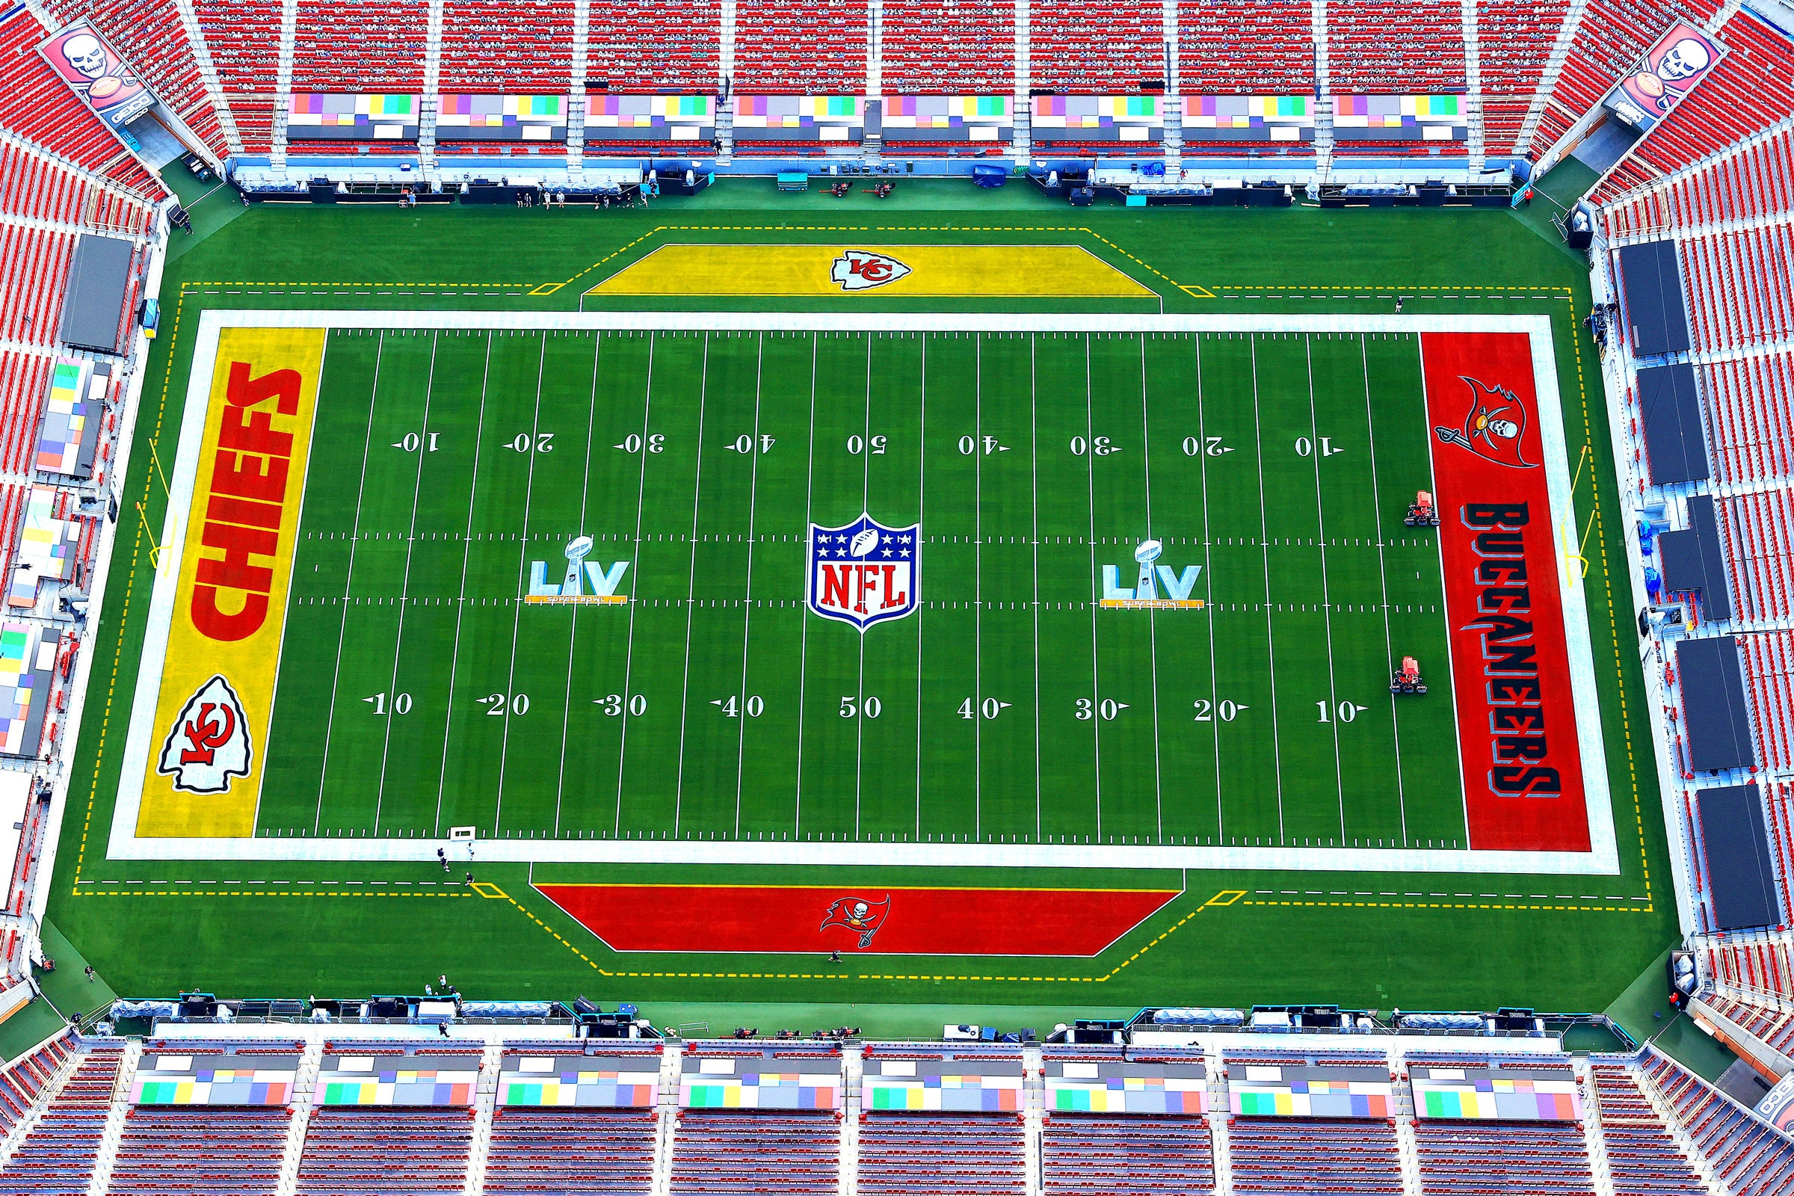
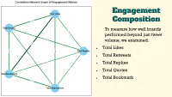
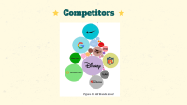
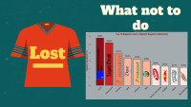
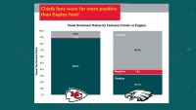
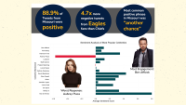
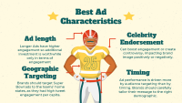
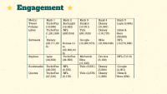
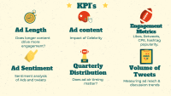

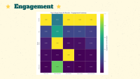
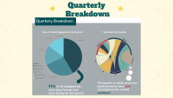
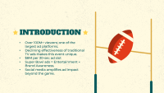
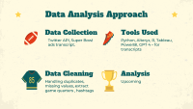
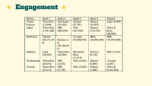

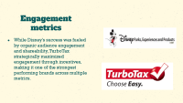
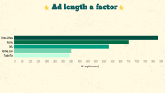
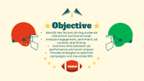
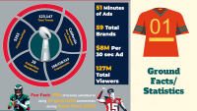
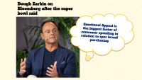
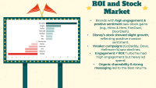
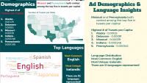
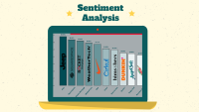
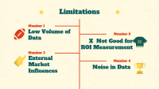

Slide 4
INTRODUCTION
Over 100M+ viewers; one of the largest ad platforms.
Declining effectiveness of traditional TV ads makes this event unique.
$8M per 30-sec ad slot
Super Bowl ads = Entertainment + Brand Awareness.
Social media amplifies ad impact beyond the game.
Notes:
"The Super Bowl is one of the most-watched live events, attracting over 100 million viewers. Unlike traditional TV advertising, where engagement is declining, the Super Bowl remains an exception, offering brands a rare opportunity to connect with a massive audience. This comes at a steep price—$8 million per 30-second slot. But is it worth it? The real impact isn’t just in viewership numbers but in how well these ads resonate with audiences, especially in today’s digital-first world."

Slide 5
Objective
Identify key factors driving audience interaction and brand recall.
Analyze engagement, sentiment, ad content, and timing.
Examine links between ad performance and stock impact.
Provide strategies to optimize campaigns and maximize ROI.
Notes:
Our objective was to analyze what makes a Super Bowl ad successful in terms of engagement and brand recall. We examined ad performance based on social media metrics, sentiment analysis, and their potential impact on stock prices. Our goal was to uncover actionable insights that can help advertisers maximize their return on investment."

Slide 6
KPI’s
Ad Length
Ad content
Ad Sentiment
Quarterly Distribution
Engagement Metrics
Does longer content drive more engagement?
Impact of Celebrity
Likes, Retweets, CPE, hashtag popularity.
Volume of Tweets
Sentiment analysis of Ads and tweets
Does ad air timing matter?
Measuring ad reach & discussion trends
Notes:
To measure ad effectiveness, we focused on six key performance indicators:
Ad Length – Does longer content drive more engagement?
Ad Content – Does celebrity endorsement influence engagement?
Ad Sentiment – Analyzing audience reactions to each ad.
Quarterly Distribution – Does ad placement within the game affect visibility?
Engagement Metrics – Likes, retweets, and hashtag popularity.
Tweet Volume – Measuring reach and overall conversation."

Slide 7
Data Analysis Approach
Data Collection
Tools Used
Data Cleaning
Analysis
Twitter API, Super Bowl ads transcript.
Python, Alteryx, R, Tableau, PowerBI, GPT 4 – for transcripts
Handling duplicates, missing values, extract game quarters , hashtags
Upcoming
Notes:
We collected data using the Twitter API, focusing on brand mentions, engagement metrics, and sentiment analysis. We also collected the ads transcript to analyze how the ad’s content, length has an effect on the brand’s virality. Tools like Python, R, Alteryx, and Tableau were used to process and visualize the data. We cleaned the data to remove spam and bot-generated content and then analyzed key patterns to draw insights.

Slide 8
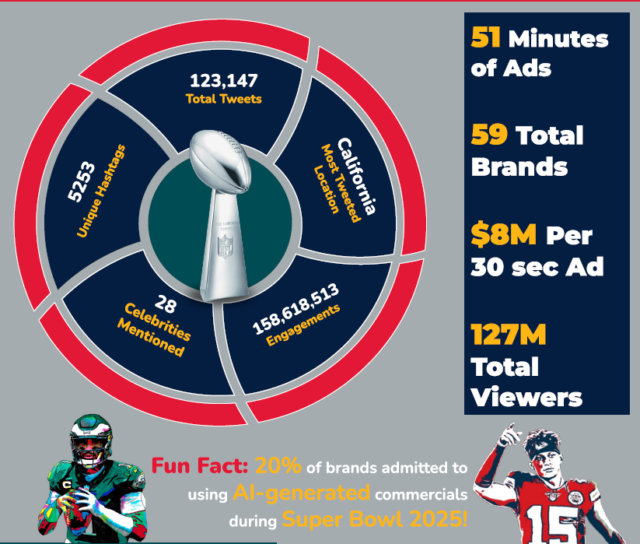

Ground Facts/ Statistics
Notes:
Before diving into engagement trends, here are some key statistics. In total, we analyzed 123,147 tweets related to Super Bowl ads.
51 minutes of ads were aired, spanning 59 different brands.
Each 30-second slot cost $8 million, making it crucial for brands to maximize impact.
The total reach exceeded 127 million viewers, with California being the most active state in Super Bowl ad discussions.
Notably, 20% of brands admitted to using AI-generated ads, marking a shift in advertising strategies.

Slide 9
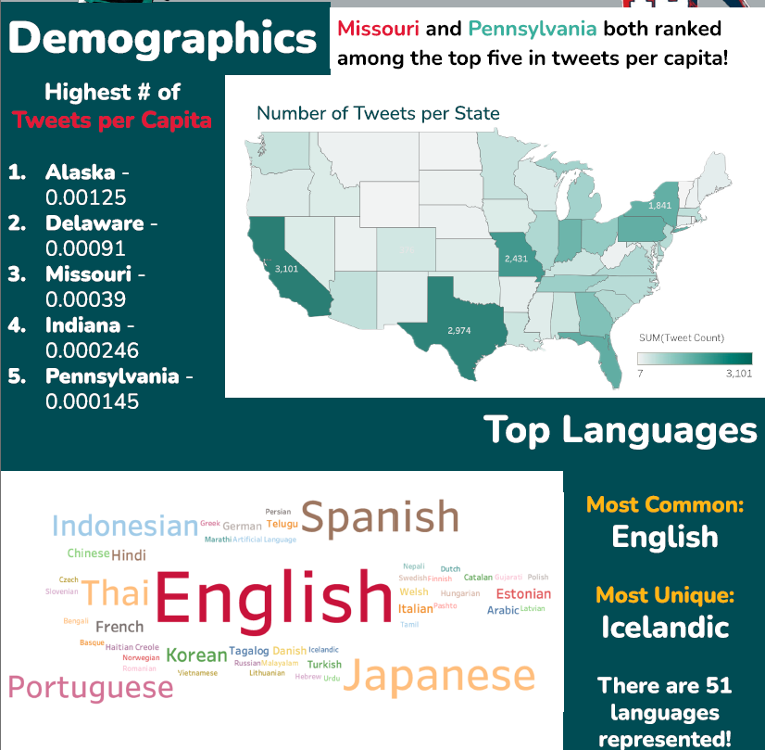
Ad Demographics & Language Insights
Missouri and Pennsylvania both ranked among the top five in tweets per capita!
Highest # of Tweets per Capita:
Alaska - 0.00125
Delaware - 0.00091
Missouri - 0.00039
Indiana - 0.000246
Pennsylvania - 0.000145
Language Distribution
Most Common: English Most Unique: Icelandic There are 51 languages represented!
Notes:
Geographically, Missouri and Pennsylvania ranked among the top five states in tweet volume per capita. We also found that English dominated the conversation, but interestingly, 51 different languages were represented, with Icelandic being the most unique. This underscores the global reach of the Super Bowl and the diverse audience engaging with the ads.

Slide 10
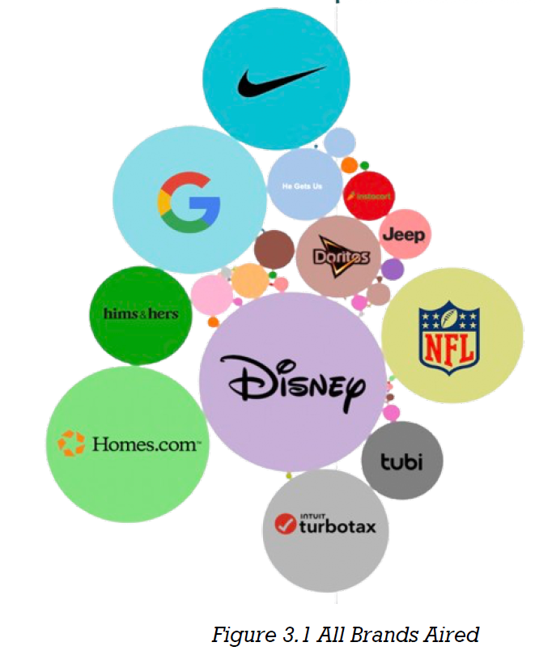
Competitors
Notes:
This visualization represents all brands that aired ads during the Super Bowl. Larger bubbles indicate higher engagement. Notably, Disney, TurboTax, and Nike dominated online conversations. However, the size of these bubbles doesn’t necessarily correlate with ad spend, meaning some brands achieved massive reach organically.

Slide 11
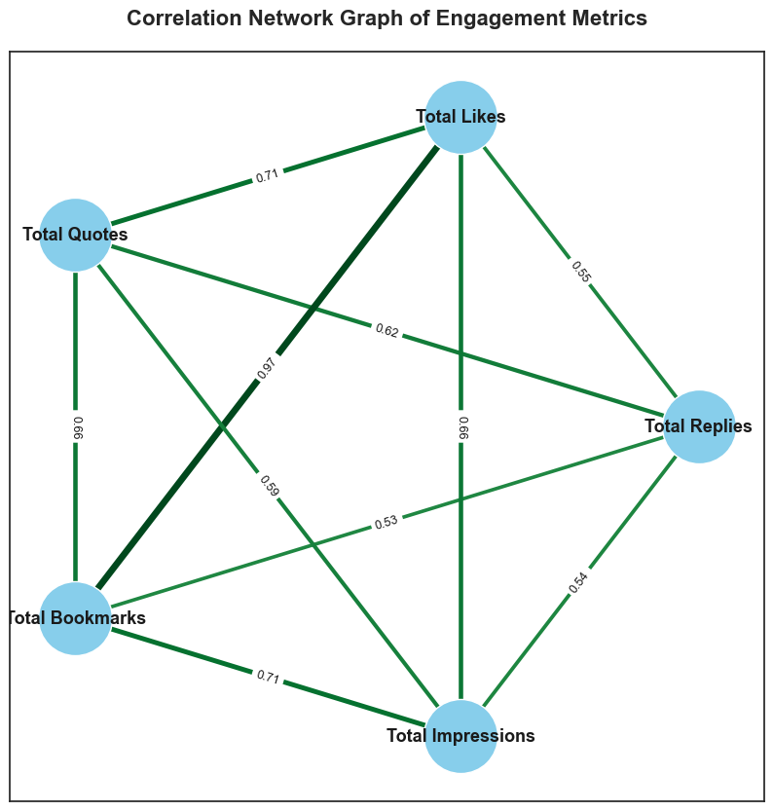
Engagement Composition
To measure how well brands performed beyond just tweet volume, we examined:
Total Likes
Total Retweets
Total Replies
Total Quotes
Total Bookmark
Notes:
To understand which brands won the social media battle, we didn’t just look at tweet volume. We examined engagement in terms of likes, retweets, replies, quotes, and bookmarks.
Retweets & quotes show virality and discussion.Likes & bookmarks suggest approval and intent to revisit.
Replies indicate direct audience interaction.

Slide 12
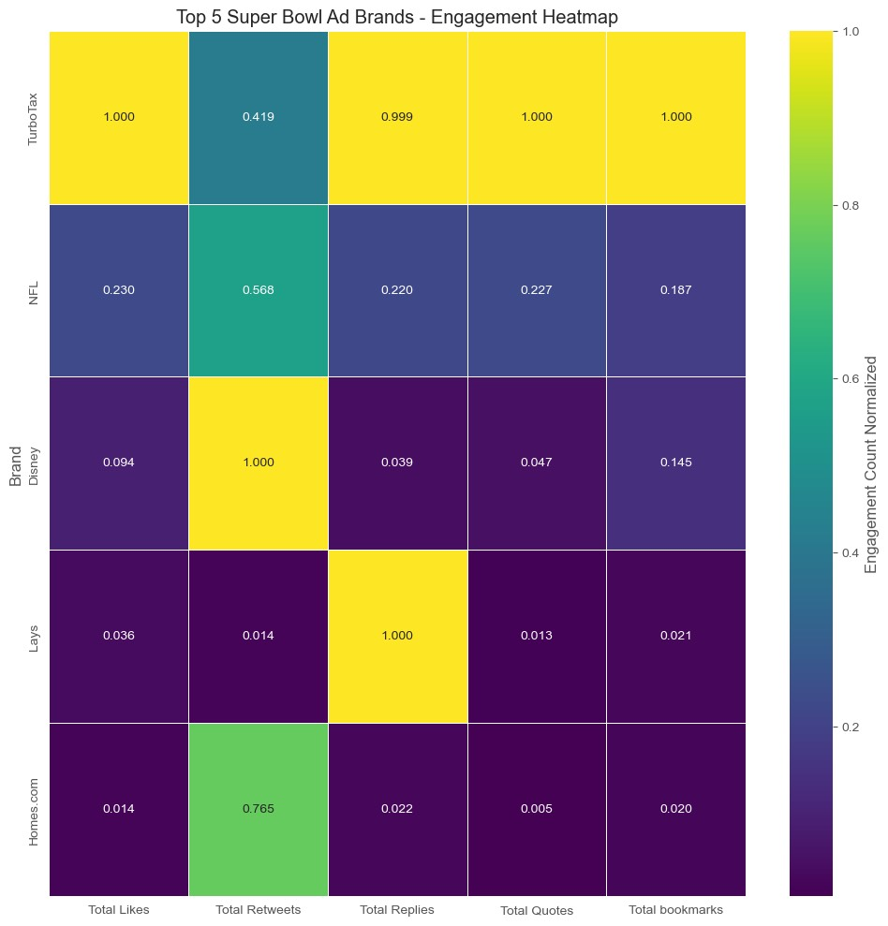
Engagement
Notes:
Disney dominated retweets, indicating strong shareability.TurboTax led in total likes, proving its ad resonated well.Lays and Doritos had high reply counts, suggesting strong audience interaction.Homes.com unexpectedly performed well, proving that even lesser-known brands can win the engagement game with the right strategy.

Slide 13
Engagement
Notes:
By assessing these dimensions, we identified top 5 brands led in each engagement category.

Slide 14

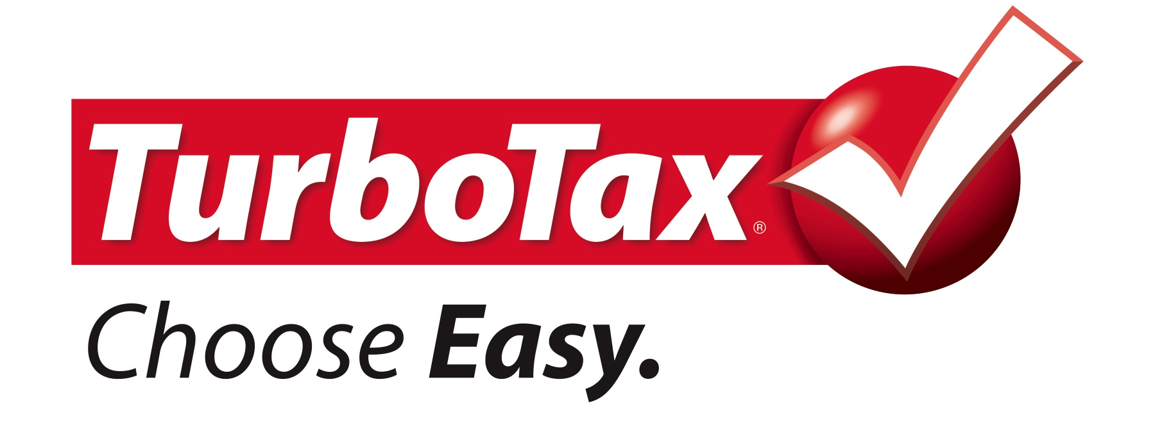
Engagement metrics
While Disney’s success was fueled by organic audience engagement and shareability, TurboTax strategically maximized engagement through incentives, making it one of the strongest performing brands across multiple metrics.
Notes:
Disney won in terms of overall engagement, dominating the retweets category with over 29 million retweets, which far surpassed all other brands. This highlights that Disney's Super Bowl campaign had the highest organic reach and virality, making it the most engaging brand of the event.
On the other hand, TurboTax performed well across almost all engagement metrics, leading in likes, quotes, bookmarks, and replies. This was largely driven by its sweepstakes campaign, which encouraged high user participation and interaction.

Slide 15
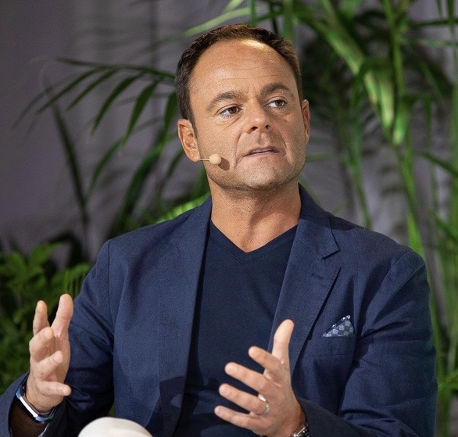
Dough Zarkin on Bloomberg after the super bowl said
Emotional Appeal is the biggest factor of consumer spending in relation to spec brand purchasing

Slide 16
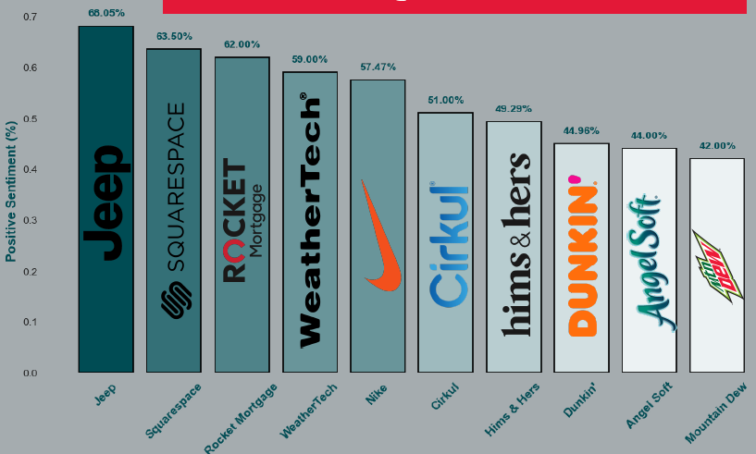
Sentiment Analysis

Slide 17
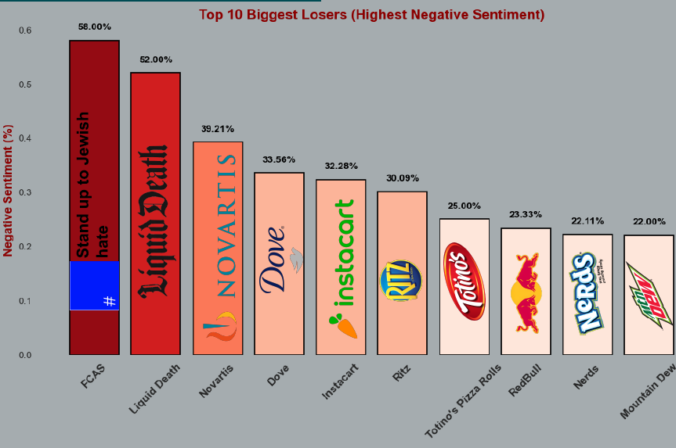
What not to do
Lost

Slide 18
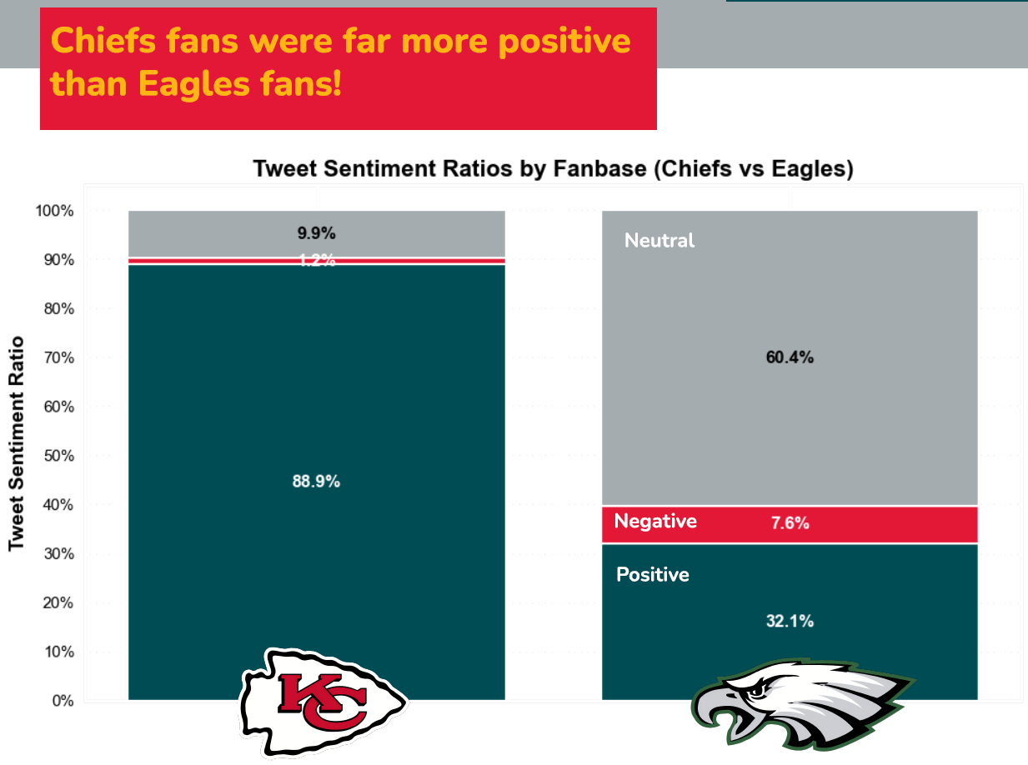

Slide 19
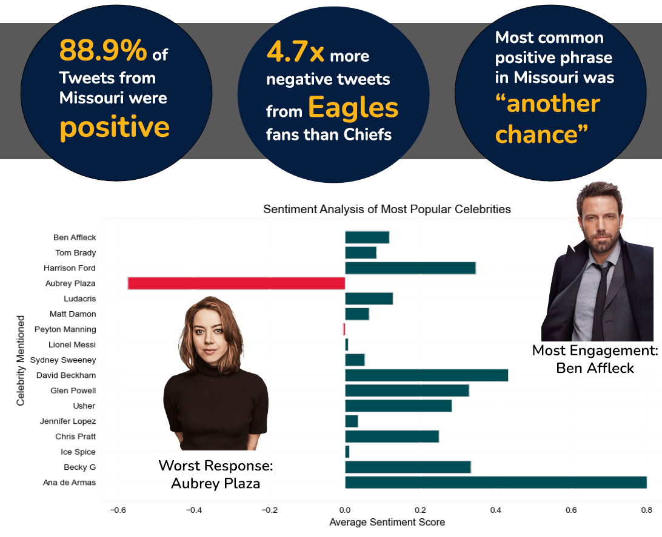

Slide 20
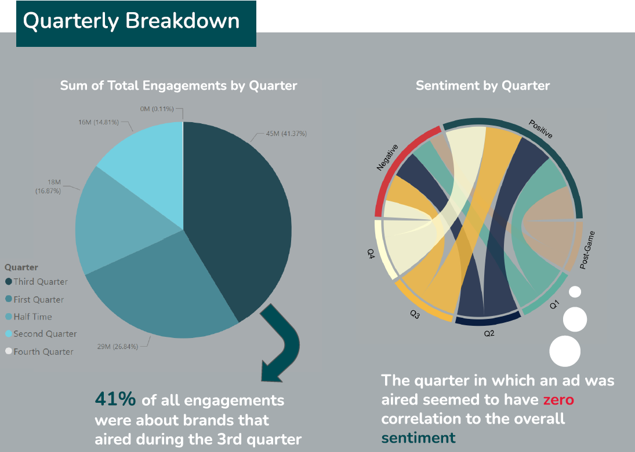
Quarterly Breakdown

Slide 21
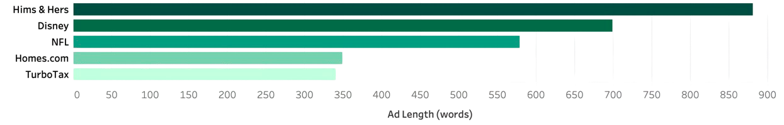
Ad length a factor
Notes:
Longer ads may enhance engagement by providing more time to connect with viewers, as seen with Disney and Hims & Hers.

Slide 22
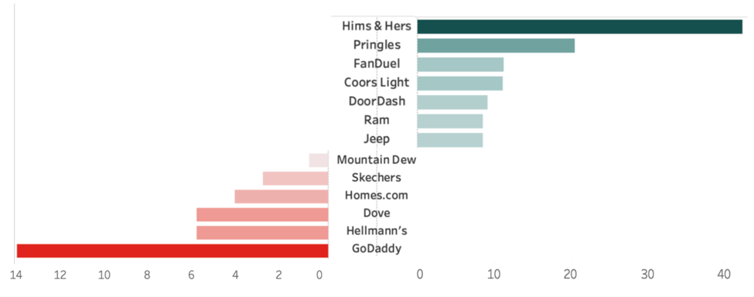
ROI and Stock Market
Brands with high engagement & positive sentiment saw stock gains (e.g., Hims & Hers, FanDuel, DoorDash).
Disney’s stock showed slight growth, reflecting positive investor sentiment.
Weaker campaigns (GoDaddy, Dove, Hellmann’s) saw declines.
Engagement ≠ ROI: TurboTax had high engagement but heavy ad spend.
Organic shareability & strong messaging led to the best returns.
Notes:
Now, let’s talk about the financial impact. Our analysis found that brands with high engagement and positive sentiment often saw stock gains.
Hims & Hers saw the biggest stock increase, reinforcing the effectiveness of its ad.
FanDuel, DoorDash, and Jeep also benefited from strong audience engagement.
On the other hand, GoDaddy and Dove saw declines, likely due to weaker reception.
Disney’s stock saw a slight uptick, reflecting positive investor sentiment.
However, engagement doesn’t always translate directly to ROI. TurboTax had massive engagement but spent heavily on multiple ads. In contrast, brands with shareable, organic content saw the best returns.

Slide 23
Limitations
Number 1
Low Volume of Data
Number 2
X Not Good for ROI Measurement
Number 3
External Market Influences
Number 4
Noise in Data
Notes:
Number 1: Low Volume of Data – Despite the Super Bowl’s massive viewership, the volume of tweets mentioning brands was still limited, which may not fully represent overall audience sentiment.Number 2: X (Twitter) Not Good for ROI Measurement – Measuring ROI through Twitter engagement alone isn’t reliable or applicable, no matter what method is used. Social media metrics do not directly translate to sales or long-term brand value. Instead, brands should focus on conversion tracking, brand lift studies, and post-campaign market analysis for a more accurate ROI assessment.Number 3: External Market Influences – Stock prices and consumer behavior are influenced by external economic conditions, making it difficult to isolate the impact of a single ad.Number 4: Noise in Data – Many tweets mentioning brands were unrelated to their Super Bowl ads, leading to potential misinterpretations of engagement and sentiment.

Slide 24
Best Ad Characteristics
Ad length
Celebrity Endorsement
Longer Ads have higher engagement so additional investment is worthwhile only in terms of engagement
Can boost engagement or create controversy, impacting brand image positively or negatively.
Geographic Targeting
Timing
Ad performance is driven more by audience targeting than by timing. Brands should carefully tailor their message to the right demographic.
Brands should target Super Bowl ads to the teams’ home states, as they had high tweet engagement per capita.
Notes:
Best Ad Characteristics
Ad Length – Longer ads drive higher engagement, making extra investment worthwhile only for engagement purposes.
Geographic Targeting – Targeting teams' home states leads to higher tweet engagement per capita.
Celebrity Endorsement – Boosts engagement but can also create controversy, impacting brand perception.
Timing – Audience targeting matters more than timing; brands should tailor messages to the right demographic.

Slide 25
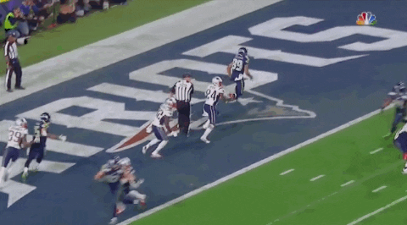
End Credits:
Prachi - Data Prep and Whitepaper
Tobias and Jack- Sentiment Analysis and Infographics
Nick- ROI and Stock Market analysis and Whitepaper
Thank You for listening
Notes:
For future research, we aim to explore AI-driven ad targeting to enhance personalization and engagement. Thank you, and we look forward to your questions.

